Slide 1
PavoneCart
Group 15: Kevin Chen, Mandeep Singh, Roshan Toopal, Haoze Wu

Slide 2
Demo Phase 1: Exploration
Mapping
Used provided SLAM package during teleop control
Object detection + logging
Objects recognized with confidence threshold
Recognized objects stored in object log (.txt)
Marker visualization
Markers created and updated at highest confidence object detection

Slide 3
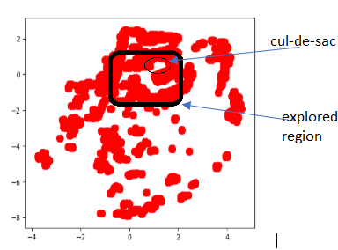
Map of cul-de-sac area after exploration

Slide 4
Demo Phase 2: Delivery
Parsing Objects & Requests
Dictionary of object names/locations parsed from obj. log
Iterate through requests & provide robot with next goal
Trajectory Planning
Used modified navigation algorithm (incorporated stop sign behavior, adjusted transition behavior) to reach goals
Updating Marker Visualization
Most immediate goal marker turns green to denote current order status

Slide 5
Design challenges
Phase I:
Auto Exploration
Choosing detection objects
Detection metrics for logging (triangulation, distance/confidence behavior)
Phase II:
Occupancy Grid - Collision threshold, window size tuning from phase I
Fast trajectory planning for far destinations
Localization drift
Confirmation of Delivery
Disconnect between simulation and physical robot (stop sign, mobilenet)

Slide 6
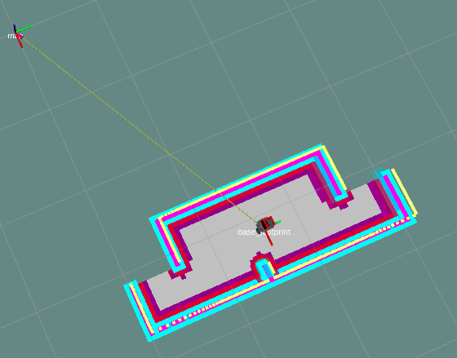
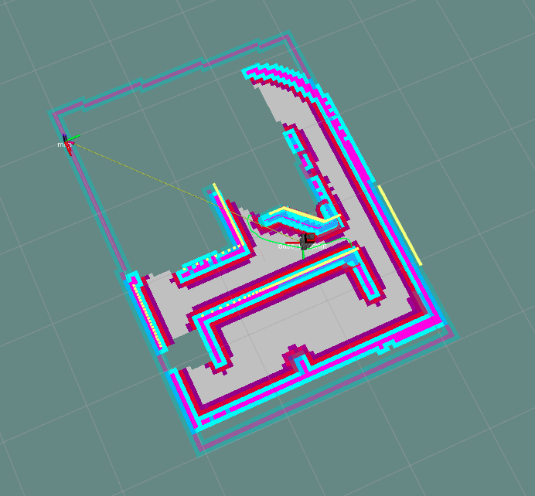
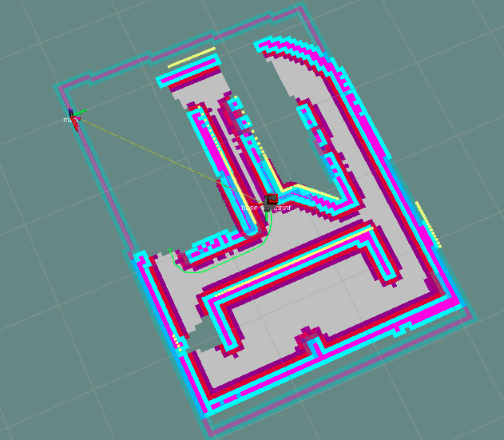
Auto Exploration

Slide 7
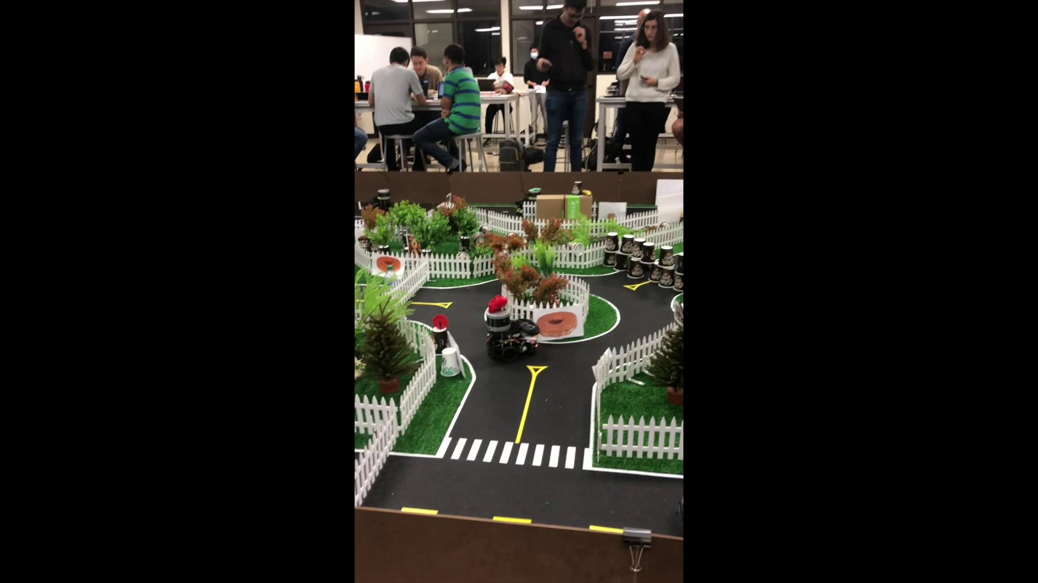
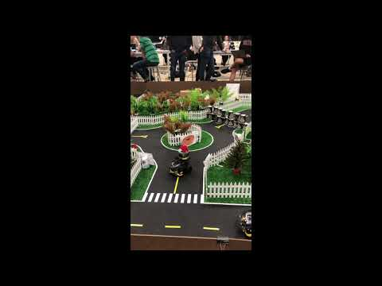
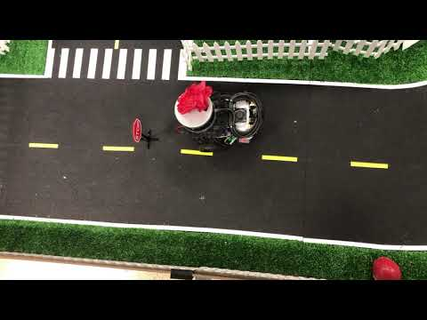
Demo video
Phase 1: exploration
Phase 2: delivery
Stop Sign Detection

Slide 8
Thank you for your attention!

